Slide 1
Computer Networks
By Shailesh Kumar Khanchandani

Slide 2
Topics Covered
Link control: Services of data link layer
Flow and error control addressing.
Media Access control: Random Access
Controlled Access and Channelization
Wired LANs and Ethernet Protocol.

Slide 3
Link control: Services of data link layer
Link control refers to the set of services provided by the data link layer of the Open Systems Interconnection (OSI) model to ensure reliable and orderly data transfer over a physical network link.
The data link layer sits between the physical layer and the network layer. It's responsible for taking packets from the network layer, breaking them down into smaller pieces called frames, and adding control information to those frames. It then transmits these frames over the physical link to the destination device. At the receiving device, the data link layer reassembles the frames into packets and passes them up to the network layer.

Slide 4
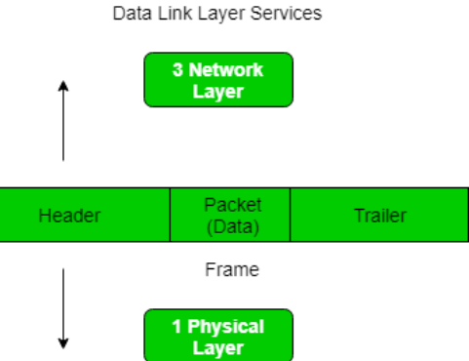
Here are the specific services provided by link control:
Framing: Divides datagrams (packets from the network layer) into manageable units called frames. Each frame includes a header containing source and destination MAC addresses, error-detection codes, and other control information, followed by the actual data payload.
Addressing: Assigns unique Media Access Control (MAC) addresses to devices on the network. These addresses are used for identifying the source and destination of each frame.
Error Detection: Ensures that the data arrives at the destination device without errors. This is typically achieved by using checksums or cyclic redundancy checks (CRCs) to detect corrupted data.
Flow Control: Prevents a sender from overwhelming a receiver with data too quickly. Flow control mechanisms allow the receiver to signal the sender when it needs to slow down transmission.
Media Access Control (MAC): Regulates how devices share the physical transmission medium (e.g., cable, wireless) to avoid collisions. Common MAC protocols include Carrier Sense Multiple Access with Collision Detection (CSMA/CD) used in Ethernet networks and Carrier Sense Multiple Access with Collision Avoidance (CSMA/CA) used in Wi-Fi networks.

Slide 5
Flow Control
Flow control and error control are both crucial mechanisms in data link layer protocols that work together to ensure reliable data transmission. They tackle different aspects of data transfer:
Function: Manages the rate at which data is sent from a sender to a receiver.
Goal: Prevents the receiver from being overwhelmed with data it can't process quickly enough.
Mechanism: Employs various techniques like:
Stop-and-Wait: Sender transmits a frame, waits for an acknowledgement (ACK) before sending the next. (Simple but inefficient)
Sliding Window: Sender transmits multiple frames within a window size, waits for ACKs before progressing the window. (More efficient)
Rate-based control: Sender transmits data based on an agreed-upon rate or receiver's advertised capacity.

Slide 6
Error Control
Function: Detects and corrects errors that may occur during data transmission over the physical link.
Goal: Ensures the received data is identical to the data sent.
Mechanism: Utilizes techniques like:
Error Detection: Uses checksums or Cyclic Redundancy Checks (CRC) to identify corrupted data packets.
Error Correction: Sender retransmits the corrupted packet upon notification by the receiver. (Requires additional mechanisms)
Forward Error Correction (FEC): Sender adds redundant data to the original data for error correction at the receiver's end. (Without needing retransmission)
Key Differences:
Focus: Flow control deals with data rate, while error control deals with data integrity.
Action: Flow control regulates transmission speed, while error control identifies and rectifies errors.

Slide 7
Addressing
In the data link layer of the OSI model, addressing plays a vital role in ensuring data gets delivered to the correct device on a network segment (like a local area network). Here's a breakdown of addressing in this layer:
What it Does:
Assigns unique identifiers (addresses) to network devices. These addresses are called Media Access Control (MAC) addresses.
Includes the source and destination MAC addresses in the header of each frame transmitted.
Enables devices on the same network segment to identify each other and receive data packets intended for them.
MAC Addresses:
Burned-in, permanent hardware addresses assigned to network interfaces (like Ethernet cards) during manufacturing.
Typically represented as a 6-byte hexadecimal value (e.g., 00:11:22:33:44:55).
Unique globally, ensuring no two devices on the internet have the same MAC address.

Slide 8
Addressing
Addressing vs. Routing:
Scope: MAC addresses are local to a network segment. They don't provide a mechanism to route data across different segments.
Function: MAC addresses help deliver data within a single network segment. Routing protocols in the network layer handle data movement across different segments using logical addresses like IP addresses.
Benefits of MAC Addresses:
Efficient Delivery: Enables devices to identify frames meant for them on a shared network segment, reducing wasted processing and collisions.
Security: MAC address filtering can be used to restrict network access to specific devices by only allowing devices with authorized MAC addresses to connect.

Slide 9
Media Access control
Media Access Control (MAC) refers to a set of protocols that govern how multiple devices share a single communication channel in a network. There are three main categories of MAC protocols:
Random Access: In random access, devices transmit data whenever they have it, without any coordination. This can lead to collisions if multiple devices try to transmit at the same time. Advocates of Linux Open-source Hawaii Association (ALOHA) and Carrier Sense Multiple Access (CSMA) are examples of random access protocols.
ALOHA: A simple protocol where devices transmit data as soon as they have it. Collisions are inevitable, and retransmission schemes are needed to recover lost data.
CSMA: Devices listen to the channel before transmitting. If the channel is busy, they wait for a random amount of time before trying again. CSMA with Collision Detection (CSMA/CD) detects collisions during transmission and retransmits data after a delay. CSMA with Collision Avoidance (CSMA/CA) tries to prevent collisions by predicting channel availability.

Slide 10
Controlled Access: In controlled access, devices take turns transmitting data. This eliminates collisions but introduces overhead for managing the order of transmission. Polling and token passing are two common controlled access protocols.
Polling: A central device (usually a switch or router) asks each device on the network one by one if it has data to transmit. This ensures orderly transmission but can be slow for networks with many devices.
Token Passing: A special token circulates among the devices on the network. Only the device with the token can transmit data. This allows for fair access and avoids collisions, but it can be complex to implement.
Channelization: In channelization, the available bandwidth of the communication channel is divided into smaller channels. Each device is assigned a specific channel to transmit data, eliminating collisions altogether. Frequency Division Multiple Access (FDMA), Time Division Multiple Access (TDMA), and Code Division Multiple Access (CDMA) are examples of channelization protocols.
FDMA: Divides the total bandwidth into frequency sub-carriers. Each device is allocated a specific sub-carrier to transmit data without interference from others. This is used in cellular networks.
TDMA: Divides the total bandwidth into time slots. Each device gets a dedicated time slot to transmit data within the slot. This is used in GSM cellular networks.
CDMA: Uses unique codes to differentiate between different devices transmitting on the same frequency band simultaneously. This is used in CDMA cellular networks and Wi-Fi.

Slide 11
Wired LANs and Ethernet Protocol
Wired LANs (Local Area Networks):
A wired LAN is a computer network that connects devices within a limited geographical area, typically a building or campus.
Devices communicate with each other using cables, most commonly Ethernet cables.
Wired LANs offer several advantages over wireless LANs:
Speed: Wired connections generally provide faster and more consistent data transfer rates.
Security: Wired connections are less susceptible to interference and hacking compared to Wi-Fi.
Reliability: Wired connections are less prone to connection drops or signal fluctuations.

Slide 12
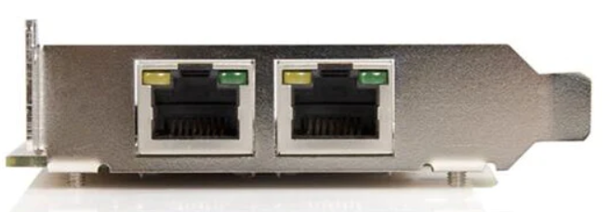
What Is An Ethernet Port ?
An Ethernet port, also known as an Ethernet jack or RJ45 port, is a rectangular connector that allows wired devices to connect to a network. You'll find them on computers, laptops, routers, printers, smart TVs, gaming consoles, and other network devices.
An Ethernet cable, with its RJ45 connector, plugs into the Ethernet port. Ethernet cables use twisted-pair cabling to minimize crosstalk (interference between cables) and ensure reliable data transmission.
Here are the different parts of an Ethernet port:
Plastic housing: The port housing is usually made of durable plastic and provides a structured enclosure for the metal contacts.
Metal contacts: These gold-plated contacts within the housing establish the electrical connection between the device and the Ethernet cable.
Locking tab (optional): Some Ethernet ports have a locking tab that helps secure the cable connection and prevent accidental disconnections.

Slide 13
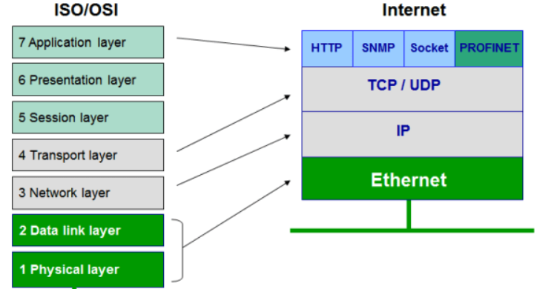
Ethernet Protocol
Ethernet is the dominant protocol used in wired LANs.
It defines a set of rules for how data is formatted, transmitted, and received over a network.
Ethernet offers several key features:
Standardized: Ensures compatibility between devices from different manufacturers.
Reliable: Uses error checking mechanisms to ensure data integrity.
Packet-based: Data is broken down into smaller packets for efficient transmission.
Multiple Speeds: Ethernet comes in various versions with different data transfer rates, ranging from the older 10Mbps (Megabits per second) to the modern Gigabit Ethernet (1000 Mbps) and even faster 10 Gigabit Ethernet.

Slide 14
Here's a deeper dive into their relationship:
IEEE Standards: The Institute of Electrical and Electronics Engineers (IEEE) defines the Ethernet standards under the 802.3 project. These standards ensure that Ethernet devices from different vendors can communicate seamlessly.
Media Access Control (MAC): Ethernet relies on CSMA/CD (Carrier Sense Multiple Access with Collision Detection) for MAC. Devices listen to the cable before transmitting. If the channel is free, they transmit. If a collision occurs (multiple devices transmit simultaneously), both devices detect it and retransmit after a random delay.
Ethernet Frame: Data is packaged into frames before transmission. An Ethernet frame includes information like the destination and source device addresses, data, and error checking codes.

